Slide 1
Apple sales price forecasting
Sanyukta Prakash Borkar
Sakshi Avadhoot Barve
Sahil Rajaram Bachate
Pranal Pradeep Chandgude Group -01
Madapaka Praveen Kumar
Anil Kumar Rajavarapu
Chaya Swaroop S
Guided By
Neha Gupta

Slide 2
BUSINESS PROBLEM
To predict the price of Apple stock for next 30 days on the basis of given data.
BUSINESS OBJECTIVE
Predict the stock price of APPLE for next 30 days on the basis of given data.
Build a model to predict the price for the said period by splitting the data into train and test set.
Find trends in short term and long term.
Impact of external factors or any events.
Methodologies
ARIMA
SARIMA
Stack LSTM

Slide 3
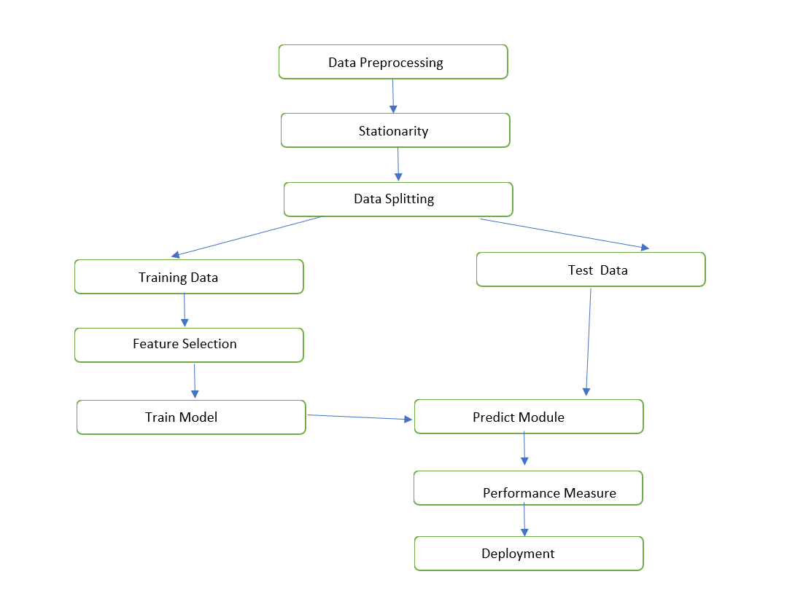
PROJECT WORK FLOW

Slide 4
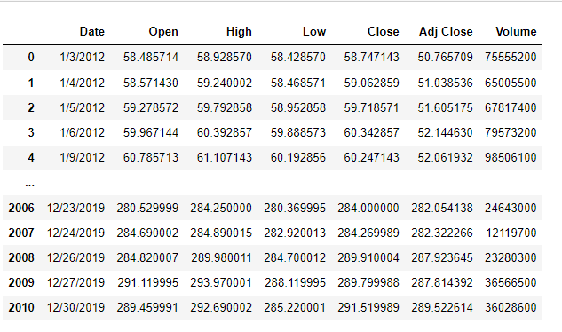
DATASET & Pre-Processing
The data used in this project consists of the historical stock prices of AAPL.
Dataset contains the following variables; Date (January 2012 - December 2019), Open, High, Low, Close, Adjusted Close and Volume.
Dataset contains 2011 rows and 7 columns.
It has float and integer values and is in Object type.
There are no null values in the data.
There are no duplicates in the data.
Data is highly correlated.
We considered Close column as the predicting feature.

Slide 5
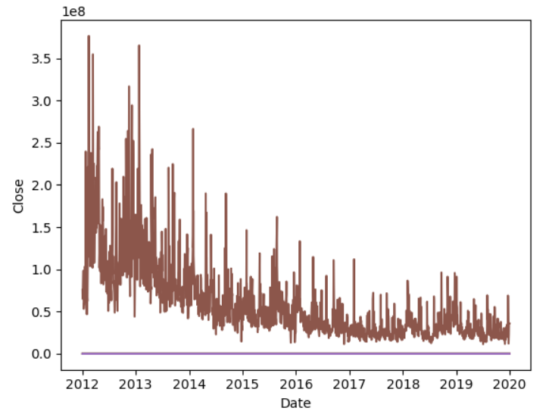
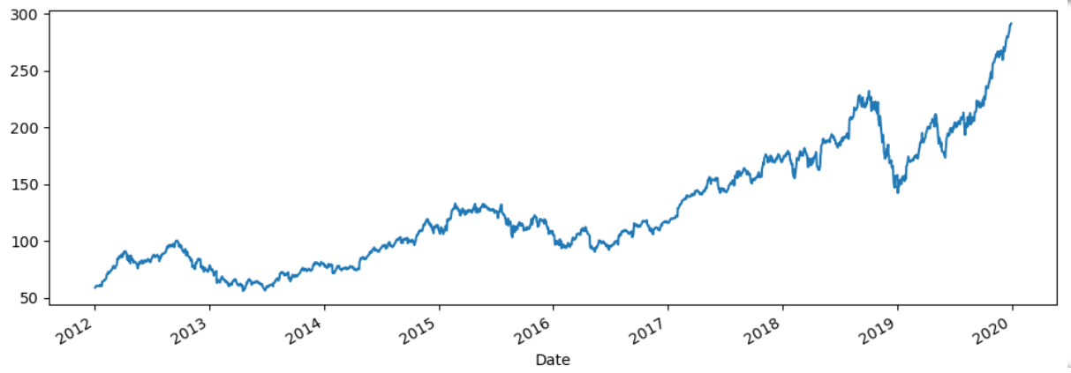
EDA Visualization
The Above plot showing the insight of close feature data’s distribution among the all the year with attachment of volume also.

Slide 6
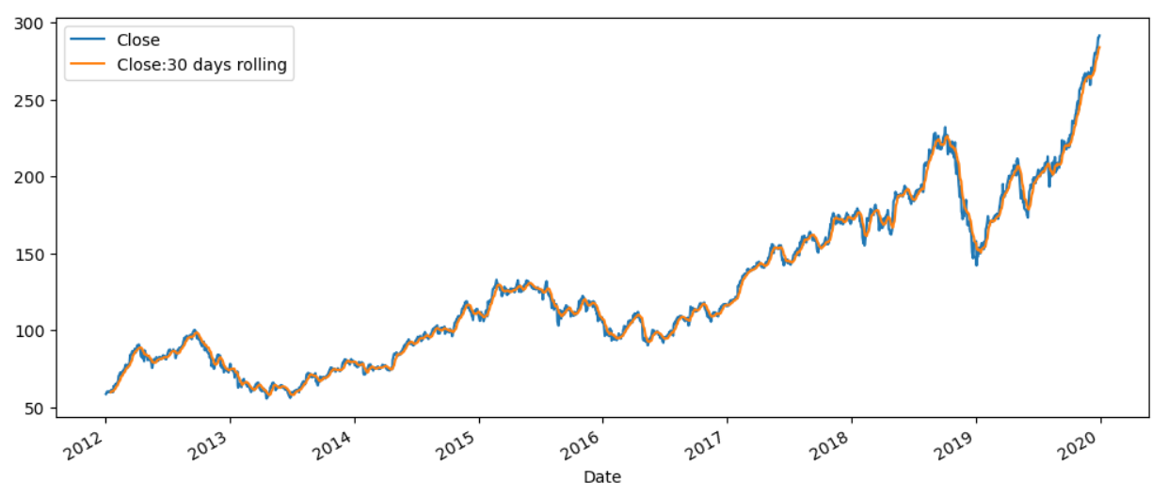
Comparison of data with Rolling Mean

Slide 7
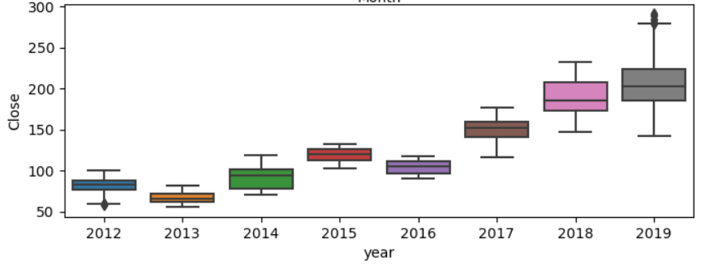
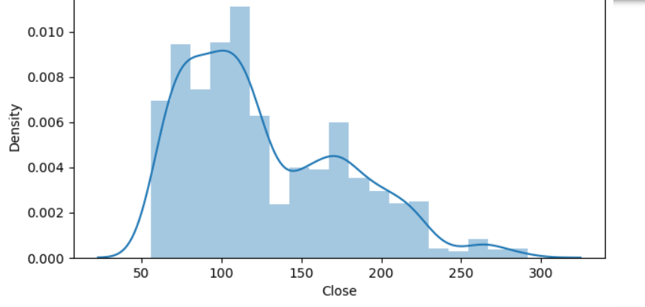
Outlier Detection
`jfegbjvbsnhegfvejsyfgsdvsffdg In this plot we found out that the data contains outliers.
The data is positively skewed.

Slide 8
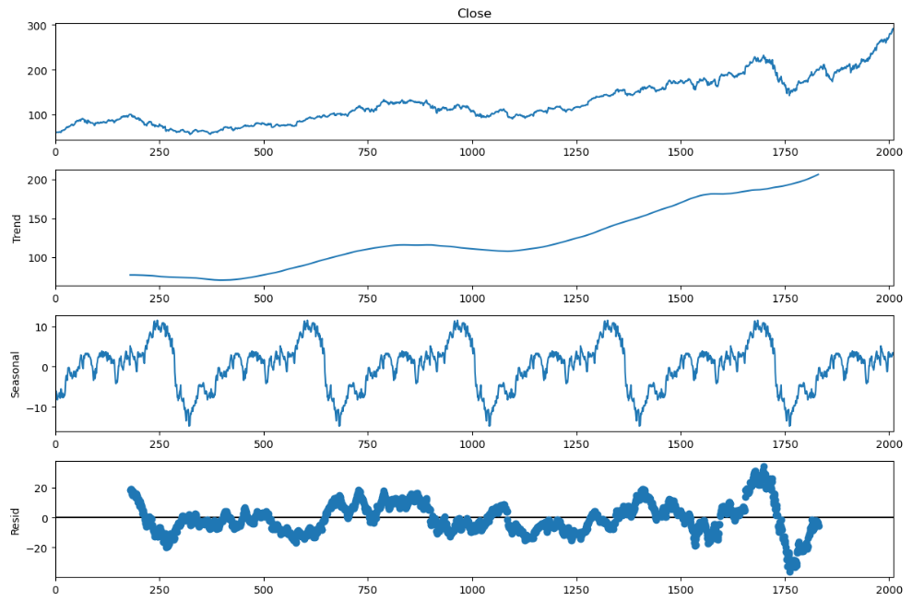
Decomposition Of Time Series

Slide 9
Model building

Slide 10
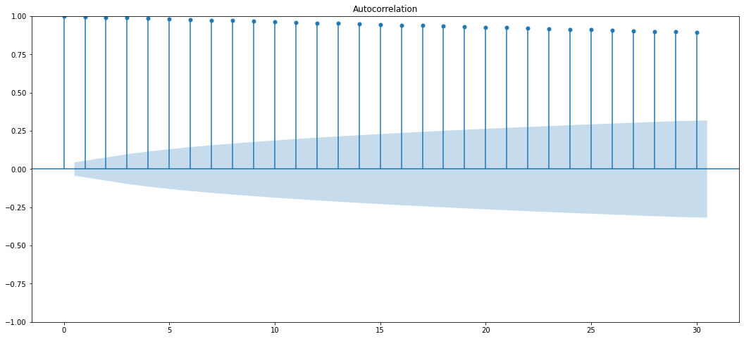
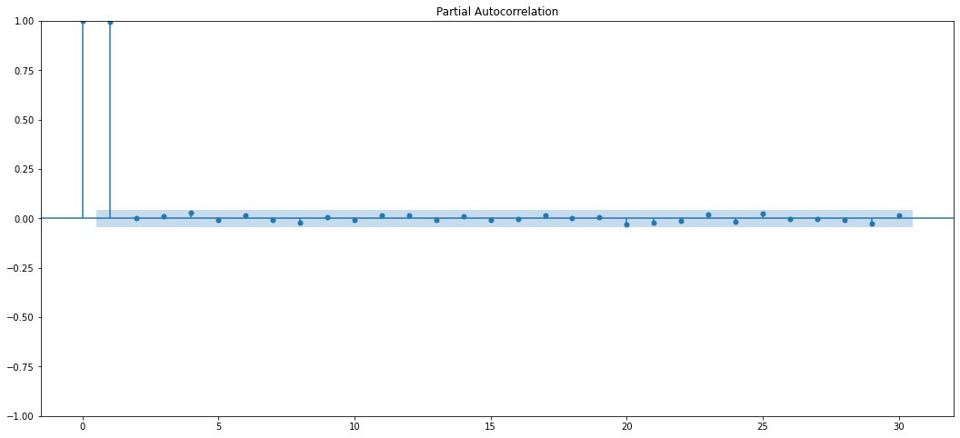
ACF plots and PACF plots (Before Differencing)
ACF Plot
PACF Plot
Augmented Dicky Fuller Test (ADF Test)
ADF Test Statistic : 1.2193479467002406
p-value : 0.9961168706935021
#Lags Used : 9
Number of Observations used : 2001
Accept Null Hypothesis. Data is Non – Stationary

Slide 11
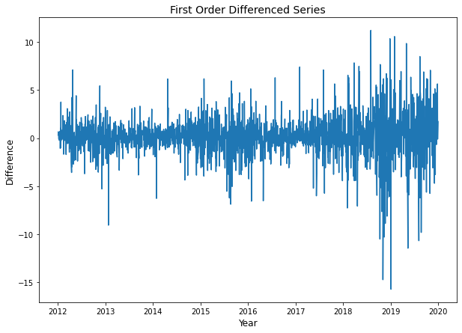
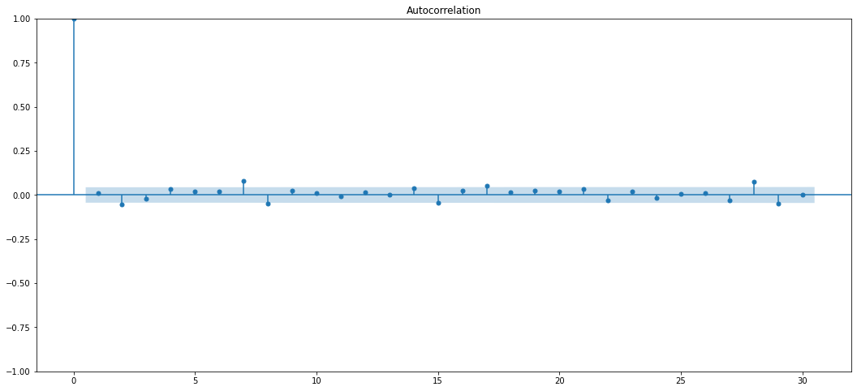
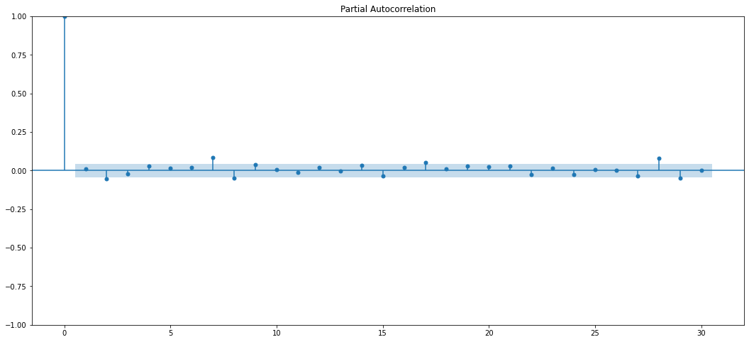
Differencing
ACF PLOT (AFTER DIFFERENCING)
PACF PLOT (AFTER DIFFERENCING)
ADF Test Statistic : -13.62553837607382
p-value : 1.7630934279439484e-25
#Lags Used : 8
Number of Observations used : 2001
Reject Null Hypothesis. Data is Stationary

Slide 12
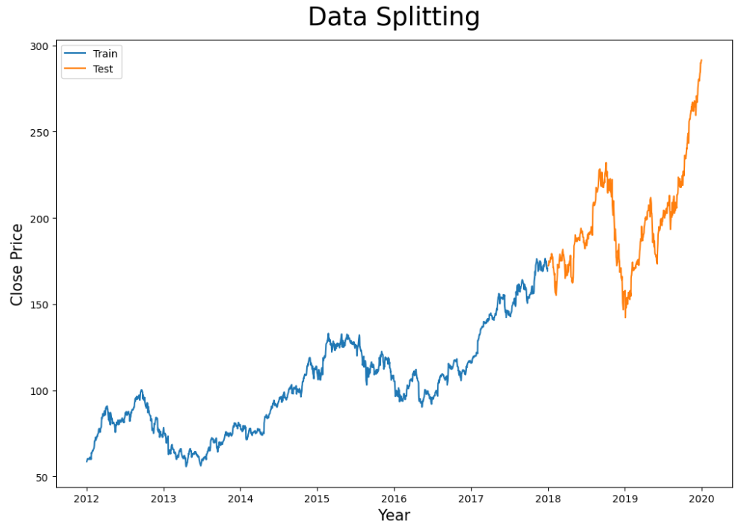
As per the objective Data has splitted as last two years as test data remaining as the train data

Slide 13
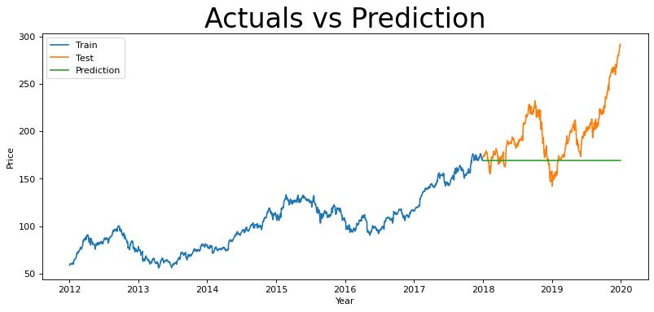
ARIMA – Auto Regressive Integrated Moving Average Model
It goes through differencing steps to eliminate the non-stationary part.
ARIMA Models are specified by three order parameters: (p, d, q),
where,
p is the order of the AR term
q is the order of the MA term
d is the number of differencing required to make the time series stationary.
So, from acf and pacf plots we concluded our p and q values and d value from stationary as (2,1,2).
With the order value of (2,1,2) we got the below results.
AIC Value – 5617
BIC Value – 5601
RMSE – 42
MAPE- 0.18

Slide 14
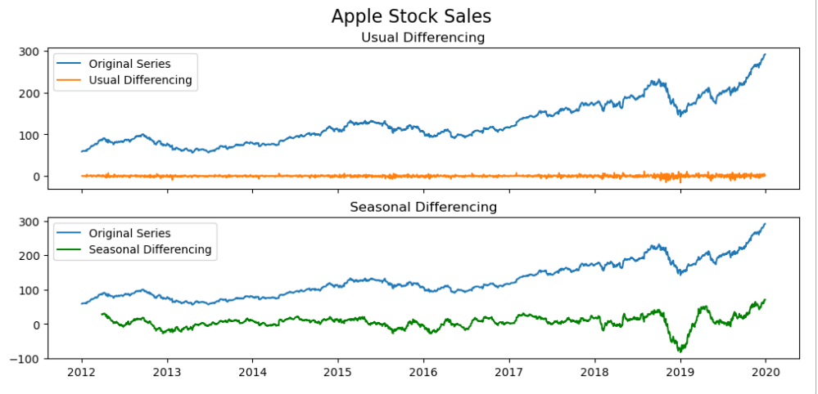
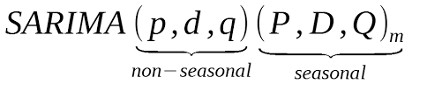
SARIMA- Seasonal Auto Regressive Integrated Moving Average Model
An extension to ARIMA that supports the direct modeling of seasonal component of the series is called SARIMA
There are four seasonal elements that are not part of ARIMA that must be configured; they are:
P: Seasonal autoregressive order.
D: Seasonal difference order.
Q: Seasonal moving average order.
m: The number of time steps for a single seasonal period.
From Seasonal plot we taken seasonality as quarterly, so final value of SARIMA order values are (0,1,2)(1,1,0,57)

Slide 15
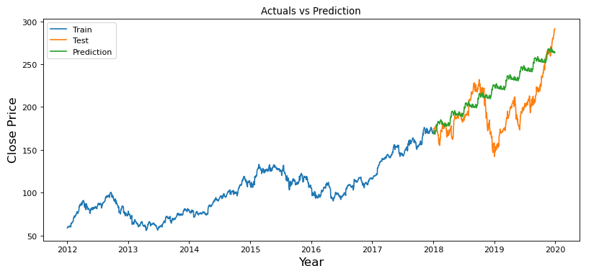
SARIMA model predicted graph
So, with the order value of (0,1,2)(1,1,0,57) we got the results like below
AIC Value – 5917
BIC Value – 5938
RMSE – 31
MAPE- 0.11

Slide 16
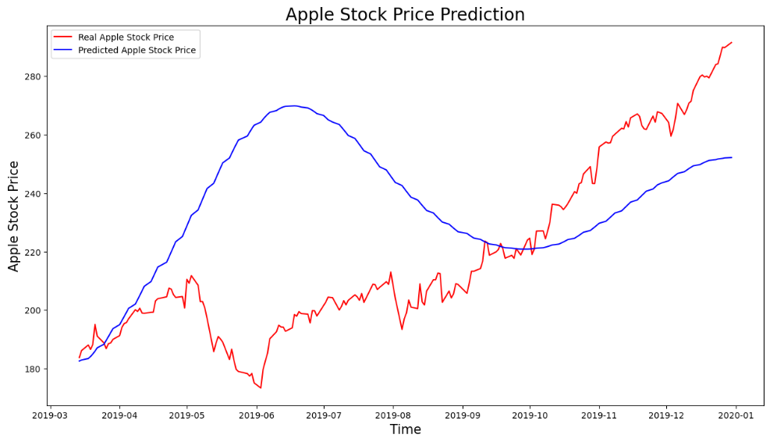
Stacked LSTM model
Stacked LSTM is DEEP Learning model for the forecasting of time series
So, after applying the deep learning model to times series we got the below results.
RMSE – 39
MAPE- 0.12

Slide 17
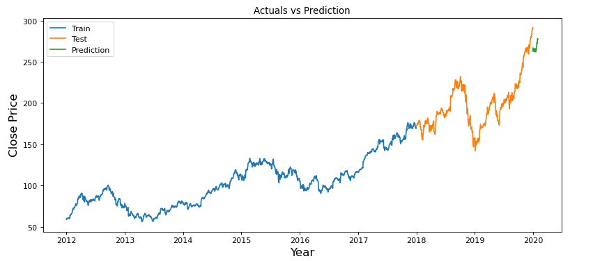
Selection of model for forecasting the future data
So, comparing the all the three models with values of RMSE and MAPE and plot of actual vs predicted finally SRIMA model is the best model for the our future prediction.
After predicting the next 30days of data with the with SARIMA model we got the values and the below is the plot for the our future prediction with the past data.

Slide 18
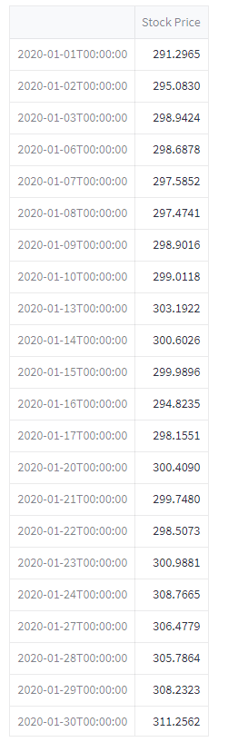
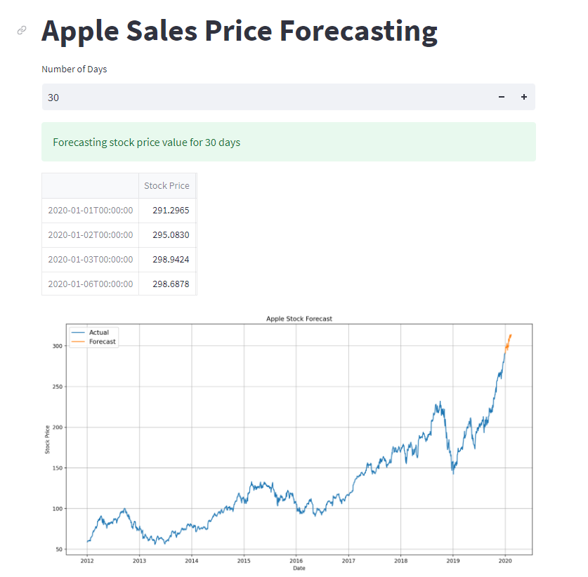
Deployment

Slide 19
Thank You

